Slide 1


M.Tech/MCA Program
Advanced Industry Integrated Programs
Jointly offered by University and LTIMindTree
Review II
Explainable Chest X-ray Diagnosis with Multimodal Learning
P.Sree Likithaa
M.Tech AI & ML
VIT Chennai
Knowledge partner | Implementation partner

Slide 2
Project Title - Calibri body 18
Introduction
Chest X-rays are the most common tool for diagnosing lung diseases.
Manual interpretation is slow, error-prone and resource-limited.
Existing AI models acct as black boxes with low trust in real clinics.
Vision-language Models enable explainable, multimodal chest X-ray analysis.

Slide 3
Project Title - Calibri body 18
Objective
To build a multimodal AI system combining chest X-rays and reports.
To provide explainable predictions with heatmaps and aligned text.
To generate radiology-style reports and support natural queries.

Slide 4
Project Title - Calibri body 18
Vision Language Model Integration
Extracts visual features from chest X-rays and text features from reports.
Aligns both in a shared embedding space.
Enables multi-disease classification and zero-shot queries.
Generates radiology-style reports automatically.
Provides explainability with heatmaps and attention maps.

Slide 5
Project Title - Calibri body 18
Methodology/Modeling Plan
Data Preprocessing & EDA
Clean OpenI / Indiana dataset.
Normalize images, tokenize reports.
Create train/validation/test splits.
Modeling
Base Vision Encoder: ResNet / ViT.
Language Decoder: Transformer (BioViL-T / BLIP).
Multimodal fusion: joint embedding space for image+text.
Explainability
Grad-CAM heatmaps for regions of interest.
Attention maps linking image regions with report words.

Slide 6
Project Title - Calibri body 18
Data preprocessing & EDA
Dataset: Indiana University Chest X-ray dataset (OpenI) – ~7,000 images +
paired radiology reports.
Image Preprocessing:
Converted DICOM → PNG/JPEG
Resized (e.g., 224×224)
Normalized pixel values
Text Preprocessing:
Extracted Findings & Impressions sections
Tokenization, stopword removal, lowercasing
Removed very short / noisy reports

Slide 7
Project Title - Calibri body 18
Data preprocessing & EDA
EDA (Exploratory Data Analysis):
Disease label distribution (Normal, Pneumonia, Effusion, etc.)
Report length statistics (word count, sentence count)
Visual inspection of sample X-rays + reports

Slide 8
Project Title - Calibri body 18
Algorithms/Tools
Vision Models: ResNet, ViT.
Language Models: BLIP, BioViL-T.
Libraries: PyTorch, Hugging Face Transformers.
Evaluation Metrics: BLEU, ROUGE, F1-score, AUC.
Deployment: Streamlit dashboard.

Slide 9
Project Title - Calibri body 18
Project plan/milestones progress
Week 1–2 → Data Preprocessing & EDA.
Week 3–4 → Model Setup (VLM + baseline CNN-RNN).
Week 5 → Explainability Module (Grad-CAM, attention).
Week 6 → Report Generation & Evaluation.
Week 7 → Dashboard Deployment + Final Review.

Slide 10
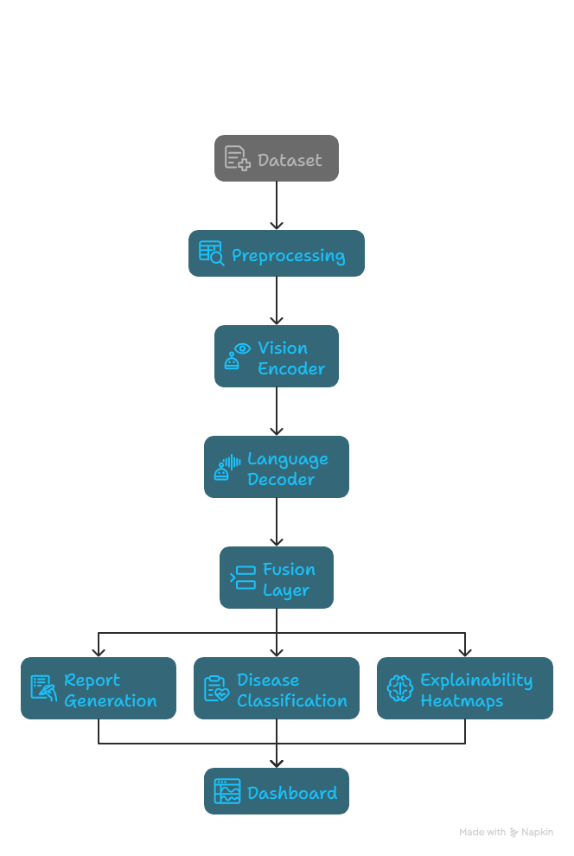
Project Title - Calibri body 18
Pipeline structure
Credits: napkin.ai

